Slide 1

ENGG404 – Lecture Chapter 7.2 The Power of Leaders to Influence Behaviour
Fundamentals of RM
RM System and Process
Leadership in RM
Incident Investigation
RM Tools & Challenges
RM in Industry
People & Org.
Applications & Perspectives
On Becoming a leader in Risk Management

Slide 2
Learning Outcomes:
Critique the relationships between you and:
your supervisor,
your peers,
your subordinates.
Recognize challenges in those relationships.
Explain how to and be able to adjust your interpersonal practices to ensure clear and consistent communication of expectations within those relationships.
Chapter 7.2 The Power of Leaders to Influence Behaviour
2

Slide 3
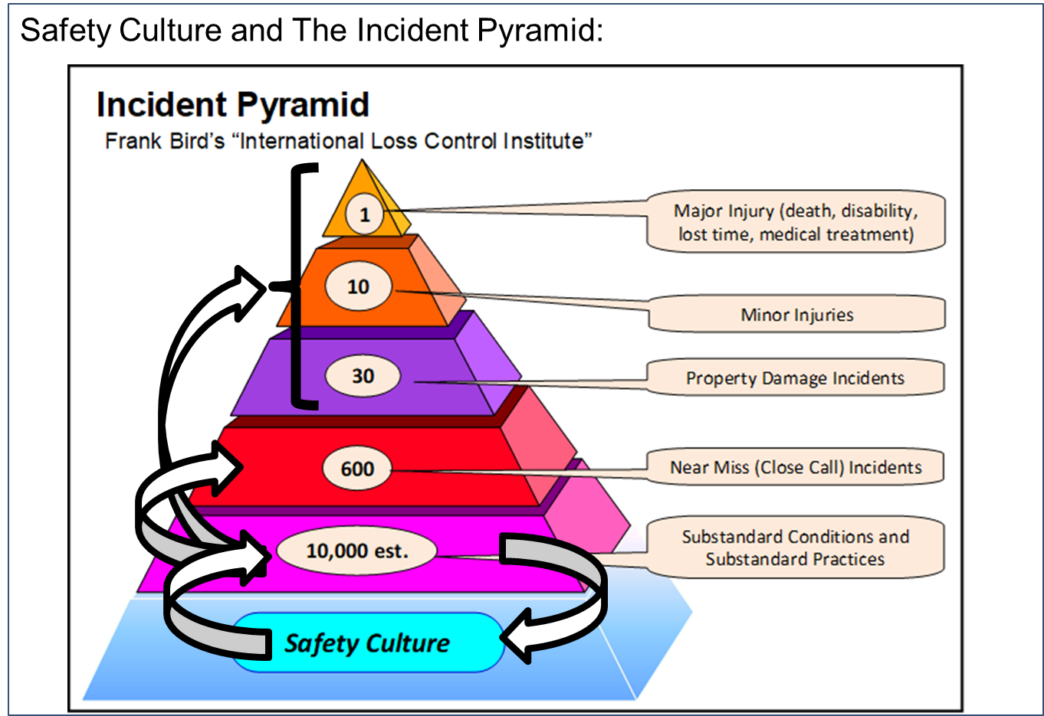
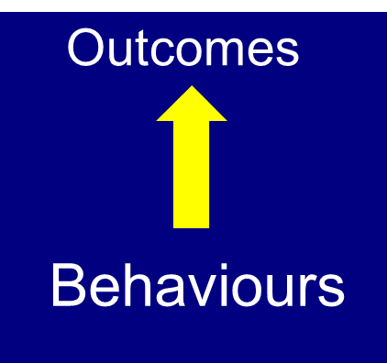
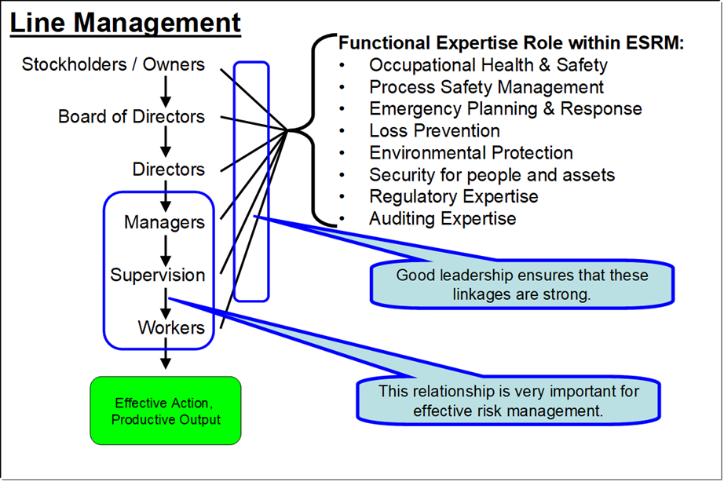
Introduction
Organizational Culture:
Leaders must provide an organizational culture that holds “excellence in safety” as a value.
Focus on Behaviours
Focus on behaviours to achieve desirable outcomes:
Reduces the occurrence of at-risk behaviours …
Improves safety performance.
Challenge: The leader, as an influencer, is in a position of authority!
Chapter 7.2 The Power of Leaders to Influence Behaviour
3
Notes:
3

Slide 4
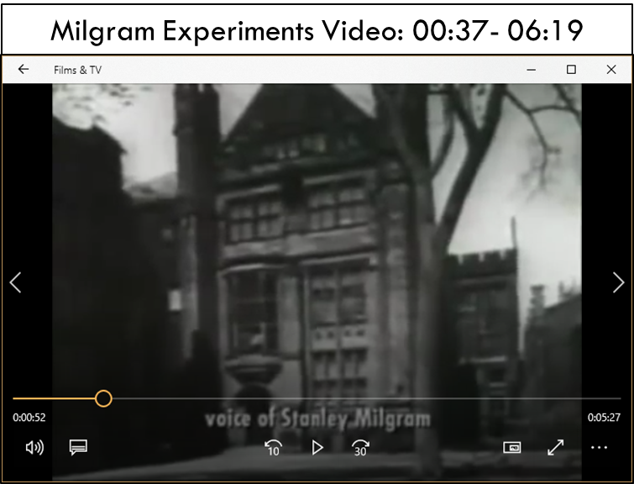
The Key Finding from the Milgram Experiments:
Position of Authority:
“… under what conditions would a person obey authority, who commanded actions that went against conscience?” Dr. Stanley Milgram (Video 00:36-00:48)
“Please continue” (the unseen voice)
The Questioner / Punisher
Responder (inside the booth, giving staged answers and getting “staged” shocks)
Chapter 7.2 The Power of Leaders to Influence Behaviour
4

Slide 5
The Key Finding from the Milgram Experiments:
Position of Authority:
“… under what conditions would a person obey authority, who commanded actions that went against conscience?” Stanley Milgram
People will do things despite conscience, ethics, values, policies …
… a “state of conflict” that they can excuse themselves of …
… by deferring to the higher authority and a diffusion of responsibility.”
“Please continue” (the unseen voice)
The Questioner / Punisher
Responder (inside the booth, giving staged answers and getting “staged” shocks)
Chapter 7.2 The Power of Leaders to Influence Behaviour
5

Slide 6
The Key Finding from the Milgram Experiments:
Position of Authority:
“… under what conditions would a person obey authority, who commanded actions that went against conscience?” Stanley Milgram
People will do things despite conscience, ethics, values, policies …
… a “state of conflict” that they can excuse themselves of by …
… deferring to the higher authority and a diffusion of responsibility.
“Please continue” (the unseen voice)
The Questioner / Punisher
Position of Authority:
We conclude that …
Position of authority leads to “obedience to authority” ...
The KEY lesson for you … A supervisor carries an incredible amount of influence, something that must be used very responsibly.
Responder (inside the booth, giving staged answers and getting “staged” shocks)
Chapter 7.2 The Power of Leaders to Influence Behaviour
6

Slide 7
Your Three Key Relationships In Your Career:
Your Direct Supervisor
You
Your Peers
The People That Work For You
Chapter 7.2 The Power of Leaders to Influence Behaviour
7
Notes:
7

Slide 8
1) You And Your Direct Supervisor:
The positions of authority:
Your Direct Supervisor
Position of Authority:
You & Your Supervisor
You
Your Peers
The People That Work For You
Chapter 7.2 The Power of Leaders to Influence Behaviour
8
Notes:
8

Slide 9
1) You And Your Direct Supervisor:
The first relationship in your Role … you and your supervisor.
Why is this relationship important to you? What are the expectations of you in this role? What challenges can you expect?
Your Direct Supervisor
You
Your Peers
The People That Work For You
Chapter 7.2 The Power of Leaders to Influence Behaviour
9
Notes:
9

Slide 10
1) You And Your Direct Supervisor:
Importance:
Supervising, coaching, mentorship towards development of you.
Career development and advancement.
People are not around “forever”: managers are always looking for good talent to develop, test, and advance to grow the organization – keep it competitive.
Expectations that Your Supervisor has of You:
Area of responsibility – ESG KP#2 “Understand Your Program”
Objectives and goals,
Policies and procedures,
Directions on tasks, jobs and projects,
“unwritten rules”.
Chapter 7.2 The Power of Leaders to Influence Behaviour
10
Notes:
10

Slide 11
1) You And Your Direct Supervisor:
Challenges to expect:
Too often the new employee, you, will not ask questions for fear of looking stupid.
Too often the supervisor is not a skilled communicator and the message they give is not clear.
Too often the supervisor is busy with other duties and finds it difficult to have enough time to spend with the new employee, you, and does not see the long-term impact.
Chapter 7.2 The Power of Leaders to Influence Behaviour
11
Notes:
11

Slide 12
1) You And Your Direct Supervisor:
And how to deal with those challenges:
Too often the new employee, you, will not ask questions for fear of looking stupid.
Building the rapport early in the relationship overcomes this challenge. “There are no dumb questions.”
Too often the supervisor is not a skilled communicator and the message they give is not clear.
Take the time and make the effort to understand your supervisor’s expectations ...
Too often the supervisor is busy with other duties and finds it difficult to have enough time to spend with the new employee, you, and does not see the long-term impact.
… Then briefly review with your supervisor to seek confirmation of your understanding.
Chapter 7.2 The Power of Leaders to Influence Behaviour
12
Notes:
12

Slide 13
1) You And Your Direct Supervisor:
Recall what the Milgram experiments were about:
The power of a position of authority – your supervisor over you!
You do not want to do something under direction of your supervisor, that your supervisor did NOT want you to do!
When seeking direction and clarifying expectations, especially when directions clash, be open and ask questions to verify your understanding.
What might at first seem to be conflicting directions, may not at all be that!
Chapter 7.2 The Power of Leaders to Influence Behaviour
13
Notes:
13

Slide 14
1) You And Your Direct Supervisor:
Some practical advice:
Ensure you are meeting expectations, and managing your responsibilities such that there are “no surprises”!
Keep your supervisor informed especially when things are not going per the plan.
Supervisors want solutions, not excuses, and not more problems.
FYI: Bosses want solutions! NOT excuses and NOT more problems!
Chapter 7.2 The Power of Leaders to Influence Behaviour
14

Slide 15
2) You and The People That Work For You:
The positions of authority:
Your Direct Supervisor
You
Your Peers
Position of Authority: You are Your Subordinates
The People That Work For You
Chapter 7.2 The Power of Leaders to Influence Behaviour
15
Notes:
15

Slide 16
2) You and The People That Work For You:
The second relationship in your Role … you and your subordinates, the people that work for you.
Why is this relationship important to you? Expectations? Challenges?
Your Direct Supervisor
You
Your Peers
The People That Work For You
Chapter 7.2 The Power of Leaders to Influence Behaviour
16
Notes:
16

Slide 17
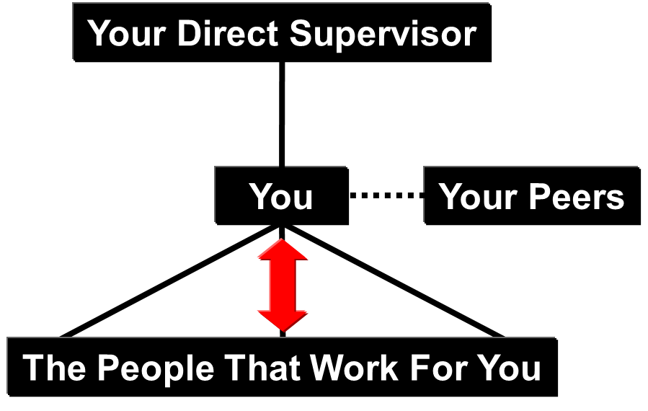
2) You and The People That Work For You:
Same relative position as you to your boss:
Everything you do to create a successful relationship with your supervisor, you should coach and expect the same in the people that work for you.
They don’t want to ask questions for fear of “looking dumb”.
They may not have the communications skills to search or probe for clarity.
They may not take the initiative to schedule time with you.
Be sure to recognize and reward them … to reinforce their (desirable) behaviours!
Chapter 7.2 The Power of Leaders to Influence Behaviour
17
Notes:
17

Slide 18
2) You And The People That Work For You:
Recall what the Milgram experiments were about:
The power of a position of authority – you over them!
Let your people know what you expect.
Don’t assume they do! Check for understanding.
If and when your expectations are confusing or conflicting, you must be open and welcoming to their questions.
Respect the person who comes to you seeking clarity.
Set realistic expectations and uphold those expectations!
“Walk the talk”.
Never compromise your expectations.
Chapter 7.2 The Power of Leaders to Influence Behaviour
18
Notes:
18

Slide 19
3) You and Your Peers:
The third relationship in your Role … you and your peers
Why is this relationship important to you? Expectations? Challenges?
Your Direct Supervisor
You
Your Peers
The People That Work For You
Chapter 7.2 The Power of Leaders to Influence Behaviour
19
Notes:
19

Slide 20
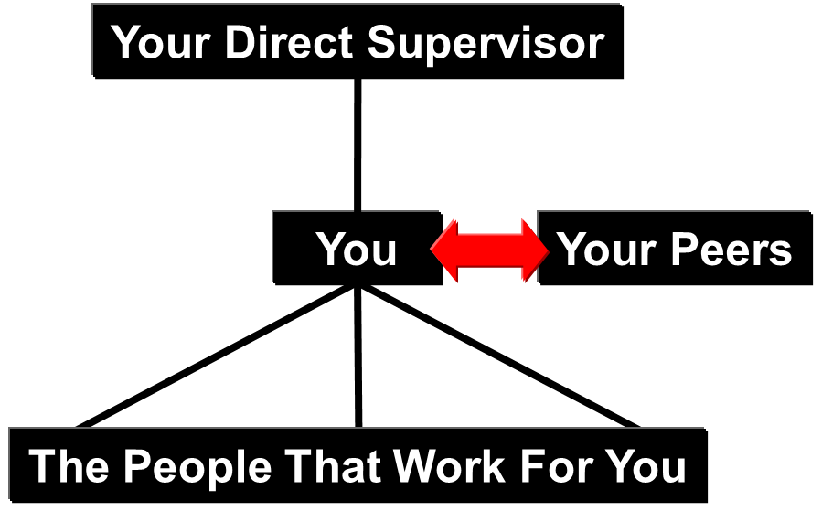
3) You and Your Peers:
Peers:
No practical “position of authority” but there most likely will be in the future.
You are building associations and relationships for the future with your future peers, your future supervisors, and with your future subordinates.
Career paths will cross, and careers will advance.
Interdependence on working towards the same goal: a successful organization.
Chapter 7.2 The Power of Leaders to Influence Behaviour
20
Notes:
20

Slide 21
Summary:
Position of authority leads to “obedience to authority”: A supervisor carries an incredible amount of influence, something that must be used very responsibly.
The three key relationships in your career have challenges and these must be managed for a successful career.
Chapter 7.2 The Power of Leaders to Influence Behaviour
21
Notes:
21

